Slide 1
Parsa‘s thesis

Slide 2
Contents
Project Seminar
RQs
  RQ1
  RQ2
  RQ3
BlackHole
Techs to use
Summary
Contact

Slide 3
RQ1 – Prompt Injection
Conformal Predictions
Certified Robustness
Pearson inequality

Slide 4
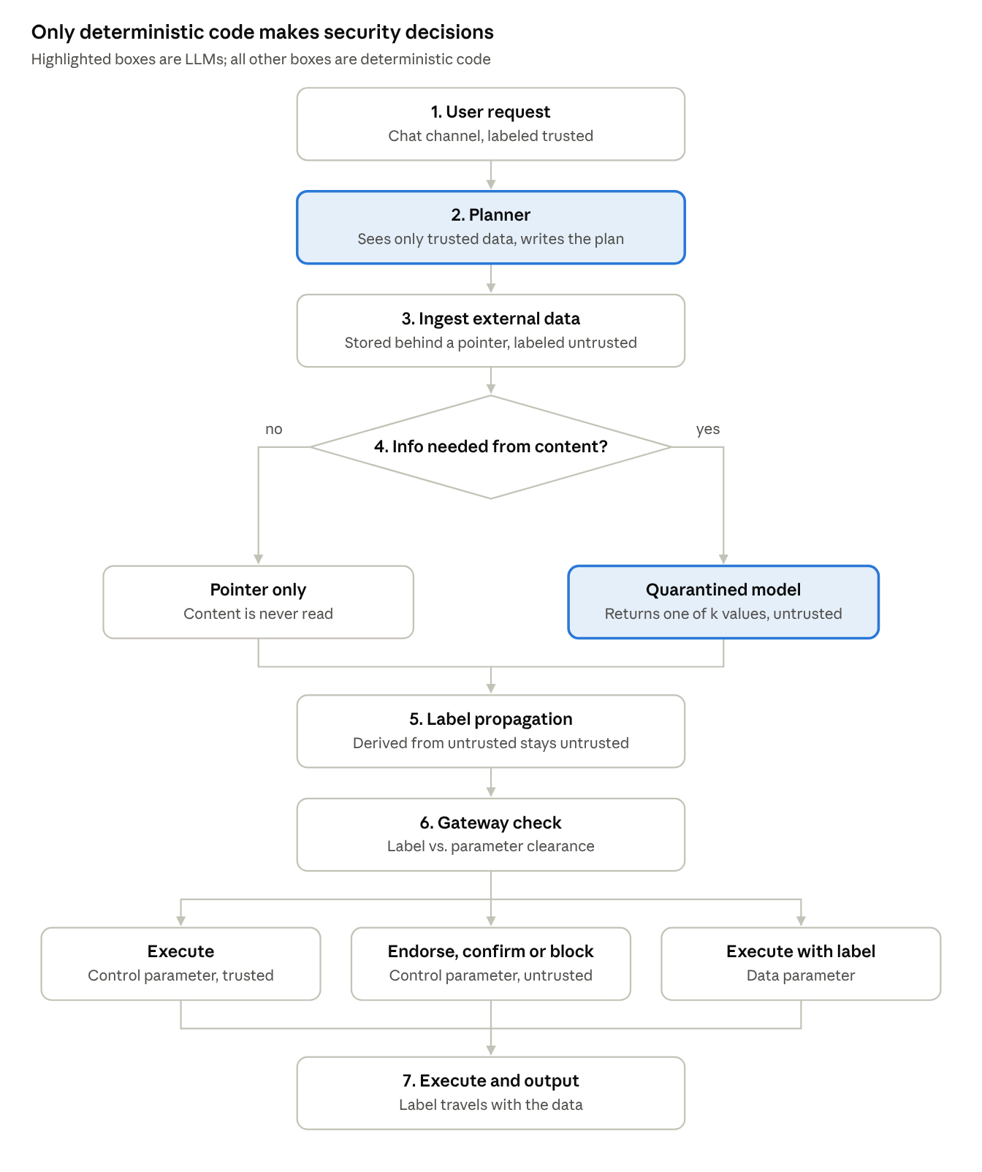
RQ1 - Horizon

Slide 5
RQ2 – Vector DB
Differential Privacy – Ro prevent Data Leakage
DP-SGD concept
Conformal Methods and bounds for posining
GraphRAG relations poisning

Slide 6
RQ 3 – Rogue AI
Monitoring
  Probablity bounds for incomming malicious tokens : This shall be over time, Via Importace Sampling + extreme Power Law + Estimate Deployments scale
  SPRT + Evalues
  Vitllie Inequality
  Rare Event estimations
Project Blackwall upgrade

Slide 7
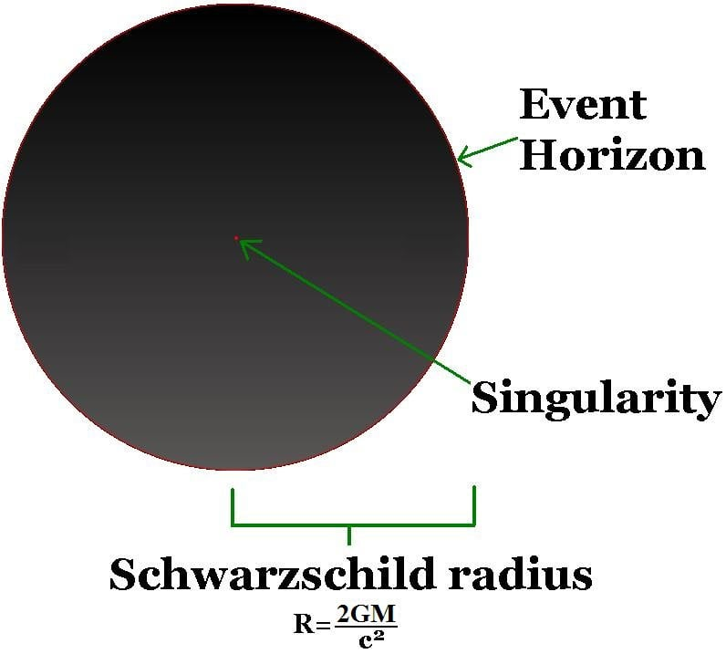
BlackHole

Slide 8
Worst Case Scenario on Each step
Sion Minimax Game

Slide 9
Evaluations
Deepteam
AgentDoji
Hoeffding intervals

Slide 10
Summary
Scope: indirect (and direct) prompt injection in RAG/agent pipelines
Spine: IFC + noninterference with a proof, enforced by (a) grammar-constrained decoding that gives unauthorized tool calls zero probability, and (b) a reference monitor that kills on violation (Schneider: safety properties are enforceable)
Probabilistic barriers: perplexity filter, classifier, reasoning/task-alignment layer, decoding-time suppression (SafeDecoding/DExperts-style), optionally circuit breakers
Internal signals → kill: suppressed probability mass, entropy spike, attention shift (Attention Tracker)
Game: finite mixed-strategy minimax over barrier configs × attack classes; kills and false positives in the payoff
Worst case: game value capped by the IFC/monitor bound
Evaluation: DeepTeam + AgentDojo on open-weights models; attack success rate and utility, with Hoeffding interval
Parking lot: smarter thinking layer, edit automata

Slide 11
Techs to use
Nvidia:
  Openshell
  Model Optimizer
  Garak
  Guardrails
Microsoft:
  Spotlighting
  GraphRag
Google
  RRSI
  Dream-RSI
  VeriHarness
  CaMeL
Adversarial Robustness Toolbox (ART) v1.20
Unstract
LLMWhisper
Chtrootkit
VLLM Guided Outline Decoding

Slide 12
Contact

